Slide 1
Bayesian Inference
Module 1, Lesson 1
Notes:
Welcome to Lesson 1 to Module 1 on Bayesian Inference.

Slide 2
Bayes Rule and its Consequences
Shahrzad Jamshidi, PhD
Notes:
In this lesson, we will explore Bayes’ Rule and its consequences. Let’s get started

Slide 3
Objectives
Understand the concept of Bayes' theorem and how it is used in statistical inference.
Define the general notation for statistical inference.
Notes:
Let’s begin with our objectives for this lesson. By the end of this session, you should be able to understand the concept of Bayes’ theorem and how it is used in statistical inference. Additionally, you will be familiar with the general notation for statistical inference.

Slide 4

What are Conditional Probabilities?
Probabilities are measurements that express how likely an event is to happen.
Example: What is the probability of rolling a 5 on a 6-sided die?
Conditional probabilities are measurements that express how likely an event is to happen ASSUMING something has occurred.
Example: What is the probability of rolling a 5 on a 6-sided die given that what was rolled was odd?
From Microsoft stock images
Notes:
Probabilities are measurements that express how likely an event is to happen. For instance, consider the probability of rolling a 5 on a 6-sided die. This is a basic example of probability.
Conditional probabilities are probabilities under the assumption that something has occurred. For example, what is the probability of rolling a 6-sided die given that what we rolled was odd?

Slide 5
Conditional Probability Notation
We use the notation to mean the probability of event A given that event B has happened
The following is the formula for a conditional probability.
Notes:
We use the notation of P of A straight-line B to mean “the probability of event A given that event B has occurred.” What you will hear me say often is “the probability of A given B” for short.
The formula to compute a conditional probability if the quotient of the probability of events A and B divided by the probability of the event B.

Slide 6
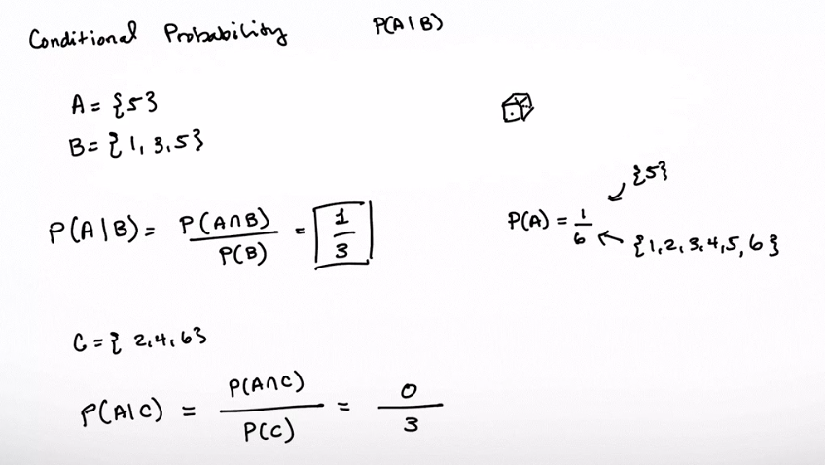
(board example inserted here)
Notes:
M1L11ConditionalProbabilityExample

Slide 7

Remark
Note:
These are NOT the same!
Example:
is the event of a shark attack
is the event of a swimming in the ocean
is the probability of a shark attack given that one is swimming in the ocean
is the probability that one is swimming in the ocean given that they have been attacked by a shark
LOW
HIGH
From Microsoft stock images
Notes:
It’s important to note that this condition on probabilities is not symmetric. So the probability of A given B is not the same as the probability of B given A.
For example, suppose A is the event of a shark attack and B is the event of swimming in the ocean
The probability of A given B represents the probability of a shark attack given that one is swimming in the ocean.
That's a very low probability event. In the US, millions swim in the ocean annually, while there are only 100 shark attacks.
The probability of B given A is the probability that one was swimming in the ocean given that they were attacked by a shark. That's a very high probability because they generally don't attack in other locations--like a grocery store.

Slide 8

What is Bayes’ Rule?
Bayes’ rule relates and .
It is a fundamental theorem a probability theory
It gives us a framework for making and updating estimates of based on evidence.
From Microsoft stock images
Notes:
While these are different, Bayes’ rule provides a way of connecting the two conditional probabilities. That’s useful since one is often much easier to compute than the other.
We can treat information on event B as “evidence.” So we can estimate the probability of A | B with B serving as available evidence for understanding event A.

Slide 9
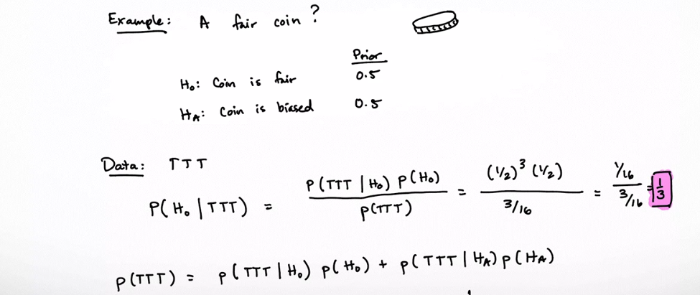
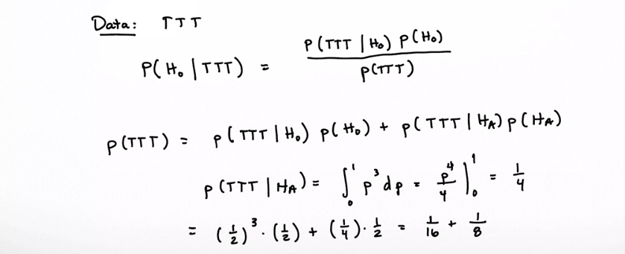
(board example inserted here)
Notes:
M1L12MedicalTestingExample

Slide 10
Terminology of Bayes’ Rule
Each part of the equation has its own term.
is the posterior probability, the thing we aim to estimate
is the likelihood
is the prior probability, the initial probability of event
is the marginal probability
While all of these are important terms, the two most important are the posterior and the prior.
The prior informs your estimate of the posterior.
Notes:
Each part of Bayes’ Rule has its own term. P(A|B) is the posterior probability, which is what we aim to estimate. P(B|A) is the likelihood, P(A) is the prior probability, and P(B) is the marginal probability. While all of these terms are important, the posterior and prior are the most crucial. The prior informs our estimate of the posterior

Slide 11
Bayesian inference
Start with a prior distribution, which represents initial beliefs.
Collect data.
Compute the likelihood: the probability of our data given our prior.
We compute the marginal probability
This ensures our estimate is normalized to 1
We compute Bayes’ rule to compute the posterior distribution
This represents our updated beliefs after seeing the data.
Notes:
Bayesian inference begins with a prior distribution representing initial beliefs. We then collect data and compute the likelihood, which is the probability of our data given our prior. The marginal probability ensures our estimate is normalized to 1. Finally, we compute Bayes’ Rule to find the posterior distribution, which represents our updated beliefs after observing the data

Slide 12
(board example inserted here)
Notes:
M1L13NullHypothesis

Slide 13
Next Time
A more detailed discussion of Bayesian inference.
Notes:
In our next session, we will delve deeper into Bayesian inference. We will explore more detailed examples and discuss how to apply these concepts in various contexts. Thank you for your attention, and I look forward to our next lesson.

